Slide 1
Risk Analysis
James Walden
Northern Kentucky University

Slide 2
Topics
Methodologies
Terminology
ALE
Data Flow Diagrams
Microsoft STRIDE/DREAD
Cigital Method
Protection Poker

Slide 3
Architectural Risk Analysis
Fix design flaws, not implementation bugs.
Risk analysis steps
Develop an architecture model.
Identify threats and possible vulnerabilities.
Develop attack scenarios.
Rank risks based on probability and impact.
Develop mitigation strategy.
Report findings

Slide 4
Risk Analysis Methodologies
Commercial
STRIDE (Spoofing, Tampering, Repudiation, Information disclosure, Denial of service, and Elevation of privilege) from Microsoft
ACSM/SAR (Adaptive Countermeasure Selection Mechanism/Security Adequacy Review) from Sun
Cigital's architectural risk analysis
Standards
ASSET (Automated Security Self-Evaluation Tool) from NIST
OCTAVE (Operationally Critical Threat, Asset, and Vulnerability Evaluation) from SEI
COBIT (Control Objectives for Information and Related Technology) from ISACA

Slide 5
Terminology
Asset: object of protection efforts.
Risk: probability an asset will suffer an event of a given negative impact, i.e. probability * impact.
Threat: agent or act who is the source of danger to assets.
Vulnerability: a defect or weakness in system security procedures, design, or implementation, that could allow a threat to be effective.

Slide 6
Threats
Accidental discovery: User stumbles on flaw with browser and exploits it.
Automated malware: Malware scans for common vulnerabilities and reports it.
Script kiddies: Unskilled attackers using automated tools written by someone else.
Motivated attacker: insider or professional attacker who targets your application.
Organized crime: specialized criminals targeting applications for financial gain.

Slide 7
Annualized Loss Expectancy
ALE = SLO * ARO
SLO = Single Loss Occurrence
ARO = Annualized Rate of Occurrence
Example
SLO = $200 for a single account's data breach
ARO = 10,000 per year
ALE = $2,000,000
Qualitative risk assessment
SLO = High(100), medium(50), low(10).
ARO = High(1.0), medium(0.5), low(0.1).

Slide 8
Justifying Security Spending
Risk Analysis
If we spend $X, it will reduce loss of $Y by Z%.
Due Diligence
We must spend $X on Y because it’s industry standard.
Incident Response
We must spend $X on Y so Z never happens again.
Regulatory Compliance
We must spend $X on Y because PCI says so.
Competitive Advantage
We must spend $X on Y to make customer happy.
Notes:
http://jeremiahgrossman.blogspot.com/2008/12/budgeting-for-web-application-security.html

Slide 9
Data Flow Diagrams
Visual model of system data flow.
Rectangles: External actors.
Circles: Processes.
Double Lines: Data stores.
Lines: Data flows.
Dotted Lines: Trust boundaries.
Hierarchical decomposition
Until no process crosses trust boundaries.

Slide 10
Trike³ Example: Data Flow Context Diagram

Slide 11
Trike³ Example: Data Flow Diagram Level 0

Slide 12
Trike³ Example: Data Flow Diagram Level 1

Slide 13
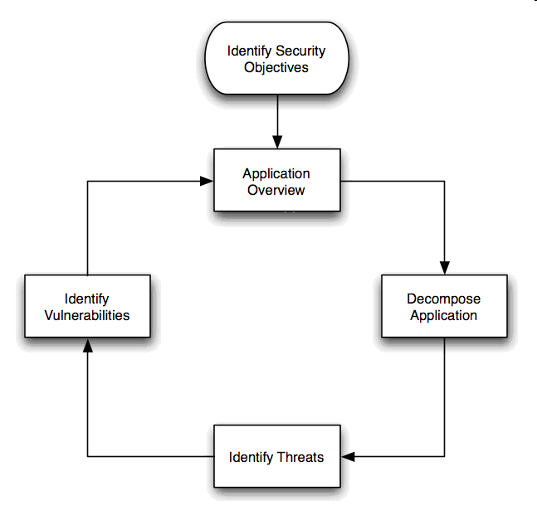
Microsoft Threat Modeling
Identify assets
Create application architecture overview.
Decompose application.
Identify threats.
Document threats.
Rate threats.
OWASP
OWASP
Notes:
Image from http://www.owasp.org/index.php/Threat_Risk_Modeling

Slide 14
Attack Trees
Decompose threats into individual, testable conditions using attack trees.
Attack Trees
Hierarchical decomposition of a threat.
Root of tree is adversary’s goal in the attack.
Each level below root decomposes the attack into finer approaches.
Child nodes are ORed together by default.
Special notes may indicate to AND them.

Slide 15
Attack Trees—Graph Notation
Goal: Read file from password-protected PC.
Read File
Get Password
Network Access
Physical Access
Search Desk
Social Engineer
Boot with CD
Remove hard disk
Notes:
Graph represents decision-making process of attacker.
Root node represents goal; leaves represent methods of achieving goals.
Leaves become more specific lower in tree.
Most child nodes represent logical ORs, but some represent ANDs (get encrypted key file AND password used to encrypt it.)
Assign values to nodes, representing perceived risk, i.e. how feasible is the attack.

Slide 16
Attack Trees—Text Notation
Goal: Read message sent from one PC to another.
1. Convince sender to reveal message.
1.1 Blackmail.
1.2 Bribe.
2. Read message when entered on sender’s PC.
1.1 Visually monitor PC screen.
1.2 Monitor EM radiation from screen.
3. Read message when stored on receiver’s PC.
1.1 Get physical access to hard drive.
1.2 Infect user with spyware.
4. Read message in transit.
1.1 Sniff network.
1.2 Usurp control of mail server.

Slide 17
STRIDE Threat Categorization
Spoofing
ex: Replaying authentication transaction.
Tampering
ex: Modifying authentication files to add new user.
Repudiation
ex: Denying that you purchased items you actually did.
Information disclosure
ex: Obtaining a list of customer credit card numbers.
Denial of service
ex: Consuming CPU time via hash algorithm weakness.
Elevation of privilege
ex: Subverting a privileged program to run your cmds.
Notes:
See also CERT’s OCTAVE assessment technique at www.cert.org/octave

Slide 18
DREAD = (D + R + E + A + D)/5
Damage Potential
Extent of damage if vulnerability exploited.
0 = Nothing
5 = Individual user data compromised
10 = Complete system or data destruction
Reproducibility
How often attempt at exploitation works.
0 = Very hard or impossible, even for admins.
5 = One or two steps required, may need authorized user.
10 = Just a web browser required, not auth needed.
Exploitability
Amount of effort required to exploit vulnerability.
0 = Advanced programming and network knowledge required.
5 = Malware exists on Internet or exploit with known tools.
10 = Just a web browser.

Slide 19
DREAD = (D + R + E + A + D)/5
Affected Users.
Ration of installed instances of system that would be affected if exploit became widely available.
0 = None.
5 = Some users, but not all.
10 = All users.
Discoverability
Likelihood that vulnerability will be discovered.
0 = Very hard, requires source code or admin access.
5 = Can figure out by guessing or sniffing network.
9 = Details of faults like this already in public domain.
10 = Information visible in web browser.

Slide 20
Quantifying Threats
Calculate risk value for nodes in attack tree
Start at bottom of tree.
Assign DREAD value to each node.
Propagate risk values to parent nodes.
Sum risk values if child nodes are ANDed together.
Use highest risk value of all children if nodes are ORed together.
Alternate technique: monetary evaluation
Estimate monetary value to carry out attacks.
Propagate values to parent nodes as above.
Note: smaller values are higher risks in this method.

Slide 21
Threat Modeling Tools
Microsoft Threat Analysis & Modeling Tool
Standalone tool
Microsoft SDL Threat Modeling Tool
Requires Visio 2007
http://msdn.microsoft.com/en-us/security/dd206731.aspx

Slide 22
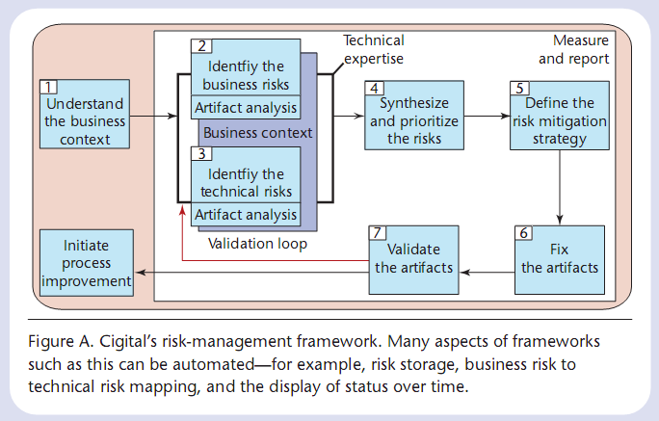
Cigital
Understand business context.
Identify business risks.
Identify technical risks.
Prioritize risks.
Define risk mitigation strategy.
Notes:
Image from bsi3-risk.pdf

Slide 23
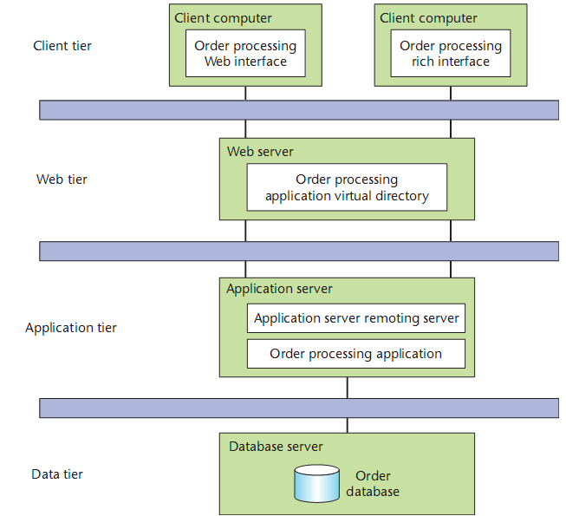
Risk Analysis Phases
Develop architectural overview.
Attack resistance analysis.
Ambiguity analysis.
Weakness analysis.

Slide 24
Attack Resistance Analysis
Find known problems with system.
Use STRIDE-type categorization.
Use checklists and attack patterns.
Types of flaws found.
Authentication tokens can be guessed/misused.
Misuse of cryptographic primitives.
Absence of a single point of entry.

Slide 25
Ambiguity Analysis
Discover new risks in the software.
Architects develop own understanding of system.
Identify conflicts between different architects.
Types of flaws found.
Protocol, authentication problems.
Password retrieval, fitness, and strength.

Slide 26
Weakness Analysis
Impact of external software dependencies.
Frameworks and shared libraries.
Network topology.
Platform.
Build environment.
Physical environment.
Types of flaws found.
Browser and VM sandboxing failures.
Insecure service provision—RMI, COM, etc.
Debug interfaces.
Interposition attacks—libraries, client spoofing.

Slide 27
Protection Poker
James Walden
Northern Kentucky University

Slide 28
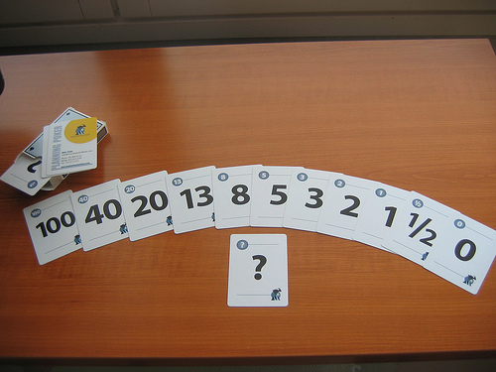
What is Protection Poker?
Collaborative, informal risk analysis technique based on planning poker.
Evaluate requirements
Ease of attack.
Impact of attack.
Risk = Ease * Impact

Slide 29
Software Security Risk Assessment via Protection Poker
Notes:
Slide from Laurie Williams’ ESSoS PPT on protection poker.
29

Slide 30
Players
Programmers
Testers
Customer representatives
Security team representative
Specialists (UI, DB, etc.)

Slide 31
Procedure
Calibrate value of system assets.
Calibrate ease of attack for requirements.
Compute security risk (value, ease) for each requirement.
Security risk ranking and discussion.

Slide 32
Calibrate Value of Assets
Examine assets listed in Table 1.
Identify least valuable asset in Table 1.
Discuss.
Assign a value of 1 in Table 1 to asset.
Identify most valuable asset in Table 1.
Use cards to achieve consensus about how much more valuable asset is.
Assign consensus value in Table 1 to asset.

Slide 33
Calibrate Ease of Attack
Identify easiest requirement to attack.
Find one that modify data, allow reads of sensitive data, have weak auth, etc.
Use cards to find consensus value.
Identify hardest requirement to attack.
Find one that doesn’t modify data, allow reads of sensitive data, has strong auth, etc.
Use cards to find consensus value.
Record ease points in Table 3.

Slide 34
Compute Security Risk
For each requirement
Identify relevant assets.
If values have already been assigned, document assets with values in Table 2.
If values have not been assigned, use cards to achieve consensus value. Record value in Tables 1 and 2.
Record max value in Table 2.
For each requirement
Use cards to achieve consensus on ease of attack. Record value in Table 3.
Compute risk by multiplying value by ease. Record the value for risk in Table 3.

Slide 35
Security Risk Ranking
Rank requirements by risk from 1 to 4.
Place value in security risk ranking Table 3.
If any rankings are a surprise, discuss and iterate with cards if necessary.

Slide 36
Why does it work?
Brings together multiple expert opinions with different perspectives on project.
Ratings focus on attack resistance analysis.
Discussions enable ambiguity analysis.

Slide 37
References
CLASP, OWASP CLASP Project, http://www.owasp.org/index.php/Category:OWASP_CLASP_Project, 2008.
Karen Goertzel, Theodore Winograd, et al. for Department of Homeland Security and Department of Defense Data and Analysis Center for Software. Enhancing the Development Life Cycle to Produce Secure Software: A Reference Guidebook on Software Assurance, October 2008.
Jeremiah Grossman, “Budgeting for Web Application Security,” http://jeremiahgrossman.blogspot.com/2008/12/budgeting-for-web-application-security.html, 2008.
Michael Howard and Steve Lipner, The Security Development Lifecycle, Microsoft Press, 2006.
Gary McGraw, Software Security, Addison-Wesley, 2006.
NIST, Risk Management Guide for Information Technology Systems, NIST SP 800-30, 2002.
OWASP, Threat Risk Modeling. http://www.owasp.org/index.php/Threat_Risk_Modeling, 2009.
Paul Saitta, Brenda Larcom, and Michael Eddington, “Trike v.1 Methodology Document [draft],” http://dymaxion.org/trike/, 2005.
Laurie Williams, Michael Gegick and Andy Meneely. Protection Poker: Structuring Software Security Risk Assessment and Knowledge Transfer. Engineering Secure Software and Systems. 2009
Laurie Williams. Protection Poker Tutorial. http://collaboration.csc.ncsu.edu/laurie/Security/ProtectionPoker/, 2008.

